Slide 1
ECON 152: MONEY AND INTEREST RATE
E. BUABENG
Department of Economics

Slide 2
Introduction
The history of money can be traced back to the barter economy(batter trade).
Barter is the direct exchange of goods and services for other goods and services.
The problems with batter trade:
double coincidence of wants
divisibility
Portability
These problems called for the introduction of a means of exchange

Slide 3
An Overview of Money
Money is defined, in simple terms, as anything that is generally accepted in exchange for goods and services and as payment for debt.
Generally, Money is anything that is generally accepted as a medium of exchange, a store of value, a unit of account, and a standard of deferred payment

Slide 4
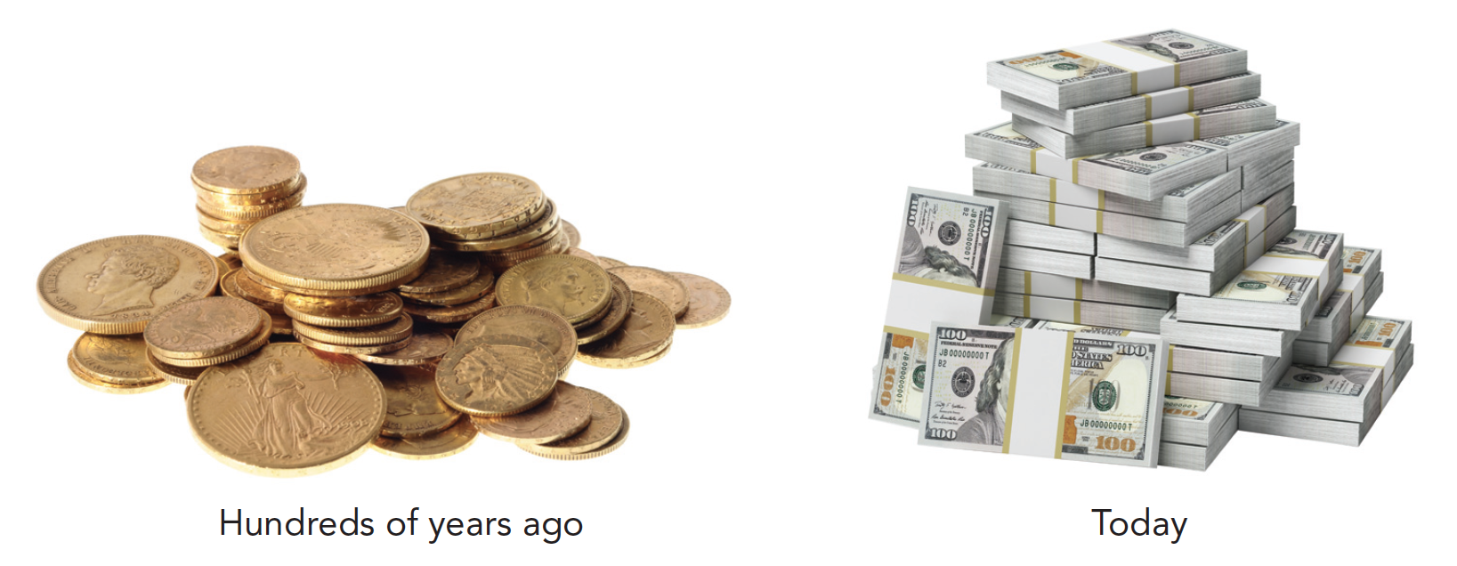
An Overview of Money
Money is an asset that people use to make and receive payments when buying and selling goods and services.

Slide 5
An Overview of Money
Money has four functions in the economy:
Medium of exchange
Unit of account
Store of value
Standard for deferred payment

Slide 6

Medium of exchange
A medium of exchange is an asset that can be traded for goods and services.
By this function, money is an item that buyers give to sellers when they purchase goods and services.

Slide 7

Money A Store of Value
A store of value is an asset that enables people to transfer purchasing power into the future.
As a store of value, money acts as an item that people can use to transfer purchasing power from the present to the future

Slide 8

Money as a Unit of Account
A unit of account is a universal yardstick that is used to express relative prices of goods and services.
Money serves as a common unit in which values of commodities are measured and expressed as basis for making comparisons.
In other words, money makes it possible for economic transactions to be measured in consistent terms

Slide 9
A standard of deferred payments
Money is the standard people use to record debts.
Example: when goods are supplied on credit the buyer uses them immediately whereas payment could be postponed over a period.

Slide 10
A standard of deferred payments
Acceptability: it must be readily acceptable to all people
2. Portability: It must be convenient to use money
3. Divisibility: Money must come in different denominations
4. Homogeneity: Money of the same value must be of uniform quality, and appearance.

Slide 11
A standard of deferred payments
5. Non-duplicability: It must not be easily counterfeited
6. Durability: Money must last a reasonable length of time before deteriorating
7. Stability of Value: It must retain its value

Slide 12
Some Terminologies
Commodity Money: This is money that takes the form of a commodity of intrinsic value. E.g. Gold
Fiat Money: This is money without intrinsic value that is used as money because of government decree. E.g. currency notes and coins
Legal Tender: Money, which is backed by law and should be accepted as a means of payment

Slide 13
Some Terminologies
4. Near Money: This is an asset, which can be converted into money. It serves as a store of value but it is not a means of exchange. E.g. shares, bonds etc.
5. Money Substitute: Anything that does not serve as a store of value but serves as a temporary means of exchange. E.g. Credit card

Slide 14
What should count as money?
Narrow definitions of money include only items that can be spent directly, such as cash and current accounts in banks (since they can be spent directly by using cheques or debit cards).
Cheques, debit cards and credit cards do not themselves count as money. Rather it is the balance in the account on which they are drawn that counts as money
Broad definitions of money also include various items such as deposit and savings accounts in banks that cannot be spent directly, but which can nevertheless be readily converted into cash

Slide 15
The Financial System
The financial system is the system that enables lenders and borrowers to exchange funds.
It encompasses all financial institutions, borrowers and lenders within the economy.

Slide 16
The Financial System
The financial system is the system that enables lenders and borrowers to exchange funds.
It encompasses all financial institutions, borrowers and lenders within the economy.
They all have the common function of providing a link between those who wish to lend and those who wish to borrow.
They act as the mechanism whereby the supply of funds is matched to the demand for funds.

Slide 17
The Financial System
expert advice
They advise their customers on financial matters: on the best way of investing their funds and on alternative ways of obtaining finance
expertise in channelling funds
They have the specialist knowledge to be able to channel funds to those areas that yield the highest return
They help to ensure that projects that are potentially profitable will be able to obtain finance and thus, they help to increase allocative efficiency.

Slide 18
The Role of the Financial Sector
maturity transformation
This is process whereby financial intermediaries lend for longer periods of time than they borrow
They are able to do this because with a large number of depositors it is highly unlikely that they would all want to withdraw their deposits at the same time.
risk transformation
This is the process whereby banks can spread the risks of lending by having a large number of borrowers.
They have the expertise to be able to assess just how risky a loan is.

Slide 19
The Banking System
The banking system consist of all deposit institutions such as the commercial banks, development banks, investment banks, savings and loan, credit unions and susu groups
Banking is defined as the practice of accepting deposits in the form of money and other valuables from the general public, with reciprocal role of giving them out on demand.
A Bank: A bank is any accredited institution whose business is the handling of other people’s money and valuables

Slide 20
Formal and Informal Banking
Formal Banking is where operate under the rules and regulations of the Central Bank.
The line of distinction between formal banking and any other type of banking (Semi-formal or informal) depends on whether their set-up and operations fall under the supervision of central bank or not, and their clearing abilities.

Slide 21
Formal and Informal Banking
Examples of some Formal Banking institutions in Ghana.
Commercial Bank
Development Bank
Merchant Bank
Rural Bank

Slide 22
Types of bank
retail banks:
They specialize in providing branch banking facilities to members of the general public, but they also lend to business, albeit often on a short-term basis. E.g. Barclays, HFC, Stanbic etc.
Their business is in retail deposits and loans (i.e. deposits and loans made through their branch network at published rates of interest).
wholesale banks
These are banks specializing in large-scale deposits and loans and dealing mainly with companies e.g. Investment Banks and finance houses
They often act as ‘brokers’, arranging loans for companies from a number of different sources

Slide 23
The banking system
Examples of some Semi-Formal and/or Informal Banking Institutions in Ghana
Credit Unions
Savings and Loan Co-operatives
Susu collectors
Rotating Savings and Credit Associations
Friends and Relatives (involved in banking activities)
Money Lenders

Slide 24
Functions of the Central Bank (Con’t)
A central bank is the bank at the apex of the banking system of a country.
It is an institution designed to oversee or supervise the banking system and regulate the quantity of money in the economy
Functions of the Central Bank
It issues notes
It acts as a bank to the gov’t and commercial banks
It manages the government’s borrowing
(i.e. national debt)

Slide 25
The Central Bank
It provides adequate liquidity to banks (lender of last resort)
oversees the activities of banks and other financial institutions
operates monetary policy
operates exchange rate policy and manages reserves

Slide 26
Deposit taking and Lending
Liabilities and Assets
Liabilities
demand deposits (withdrawn immediately without notice or penalty)
time deposits
certificates of deposit
sale and repurchase agreements

Slide 27
Deposit taking and Lending
Assets
cash and balances in the central bank
short-term loans (market loans, bill of exchange)
longer-term loans

Slide 28
Which of the following would be classified as a liability of a bank?
Q
Holdings of ‘toxic’ debt
Current account deposits
Reserves in the central bank
Loans to other banks
Customers’ overdrafts

Slide 29
Which of the following describes a ‘repo’?
Q
Where a bank agrees to buy certain assets from an institution for cash in return for being able to borrow from that institution in the future.
Where a bank sells some assets (e.g. bonds) and agrees to buy them back at a particular price after a set period of time.
Where bank X lends to bank Y provided that bank Y is prepared to lend to bank X in the future.
Where a bank sells assets to person or institution X in return for buying assets from person or institution Y.

Slide 30
Which of the following would be classified as liquid asset of a bank?
Q
Sight deposits
Time deposits
Personal loans
Certificates of deposit in other banks
Repos with the central bank

Slide 31
Liquidity and Profitability
Banks have the two conflicting aims of liquidity and profitability.
The liquidity of an asset is the ease with which it can be converted into cash without loss.
Cash itself, by definition, is perfectly liquid
Other assets like personal & business loans, mortgages & T-bills are less liquid
In general, the more liquid an asset, the less profitable it is, and vice versa

Slide 32
Liquidity and Profitability
For reasons of profitability, the banks will want to ‘borrow short’ and ‘lend long’
they want to hold illiquid assets in order to make a profit
after all, the less liquid the asset (i.e long-term loans), the greater the interest the bank is likely to be able to charge

Slide 33
The money Supply

Slide 34
Definitions of the money supply
The money supply or the money stock refers to the quantity of money circulating/available in an economy.
Money stock for an economy includes not just currency but also deposits in banks and other financial institutions that can be readily accessed and used to buy goods and services
monetary base (money in circulation)
broad money

Slide 35
Definitions of the money supply
The money stock of Ghana includes the following:
High – Powered Money or The Monetary Base (M0) – this is made up of currency (paper notes and coins) issued by the central bank.
Narrow Money Supply (M1) – this includes currency outside banks and demand deposits.

Slide 36
Definitions of the money supply
3. Broad Money Supply (M2): this is made up of M1 and all quasi – money (savings deposits, time deposits, certificate of deposits).
4. M2+: this is made up of M2 plus foreign currency deposits and amount available on credit cards

Slide 37
MONEY CREATION
Printing of currencies constitutes an infinitesimal fraction of a nation’s total money supply.
Other origin that account for a change in a nation’s stock of money is termed as money creation or deposit or credit creation.
Commercial banks create money out of a system called fractional-reserve banking.
Fractional-reserve banking is a banking system in which banks hold only a fraction of deposits as reserves

Slide 38
MONEY CREATION
Deposits that banks have received but have not loaned out are called reserves.
Reserves are kept to meet withdrawals by depositors.
Excess reserve is loaned out, which goes a long way to increase money supply in the economy
The reserve over the total deposits is called cash ratio

Slide 39
MONEY CREATION
Some Terminologies
Total Reserves/Deposit: This is made up of the total amount of money that customers deposit with the bank for safekeeping.
Minimum Reserve Ration/Cash Ratio: This is a statutory requirement from the central bank stipulating that commercial banks should hold a fraction of their total deposits against possible demands or withdrawals.
Required reserves = minimum reserve ratio/cash ratio times total deposits

Slide 40
MONEY CREATION
Required reserves = minimum reserve ratio/cash ratio times total deposits
Excess Reserves: This is the difference between the minimum required reserves and the total deposit
Excess reserves equal total reserves minus required reserves

Slide 41
MONEY CREATION
Deposit creation process
Assuming initial deposits are Gh¢1000 and Required reserve ratio is 10%

Slide 42
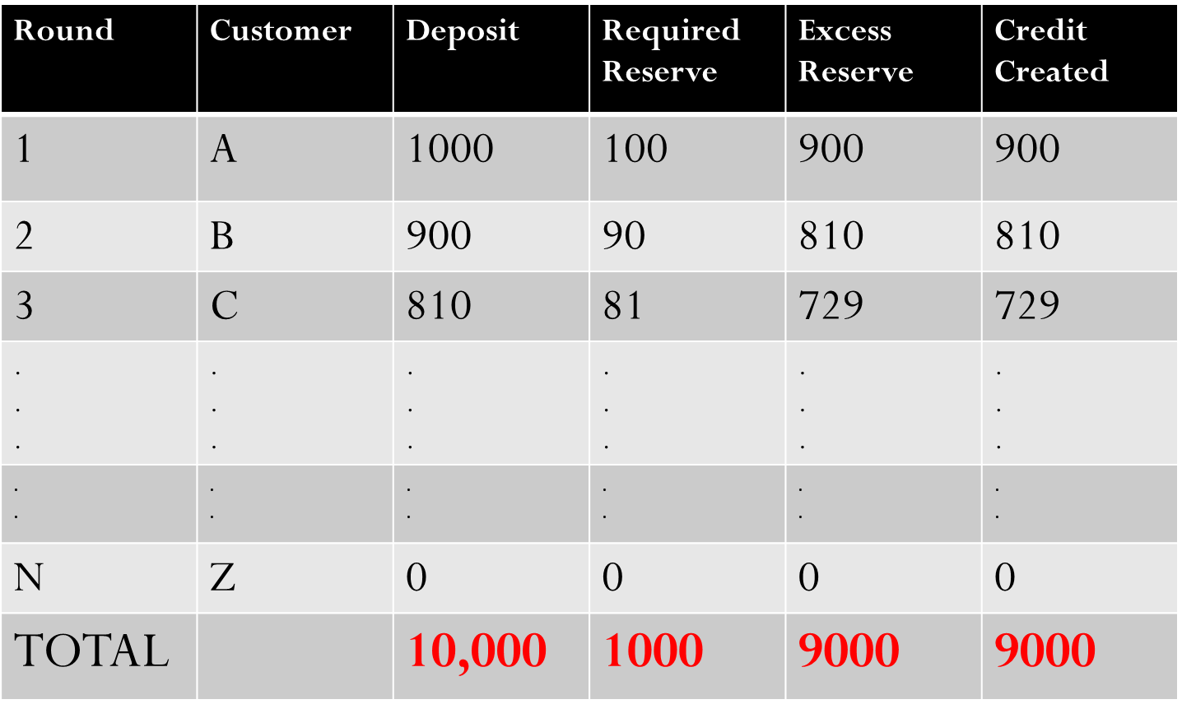
MONEY CREATION
Deposit creation process

Slide 43
MONEY CREATION
The initial deposit of Gh¢1000 with the commercial has allowed the bank to create additional money Gh¢9000, making a total increase in money supply from Gh¢1000 to Gh¢10000.
This effect is known as the bank (or deposits) or money multiplier.
In this simple example with a cash ratio or liquidity ratio of 10%, the bank multiplier is 10.

Slide 44
MONEY CREATION
The initial deposit of Gh¢1000 with the commercial has An initial increase in deposits of Gh¢1000 allowed total deposits to rise by Gh¢9000.
In this simple world, therefore, the bank or money multiplier is the inverse of the cash ratio or liquidity ratio (1/0.1=10)
The ability of the commercial bank to create deposit depends on:
The size of their total reserves and
The cash ratio/excess reserve

Slide 45
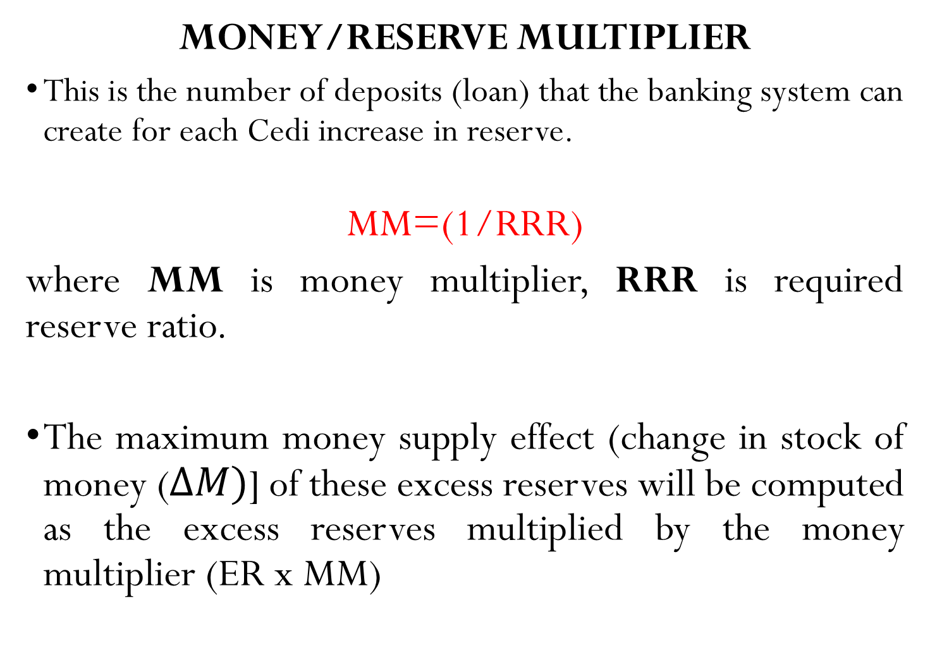
Notes:
7

Slide 46
MONEY CREATION
The ratio of the increase of deposits to an expansion of banks’ liquidity base is called the ‘bank multiplier’.
The money (or bank deposit) multiplier is the reciprocal of the reserve or liquidity ratio:
M = (1/RRR)
With L = 10% or 1/10,
The multiplier is 10.
An initial increase in deposits of ¢100 billion allowed total deposits to rise by ¢1000 billion.

Slide 47
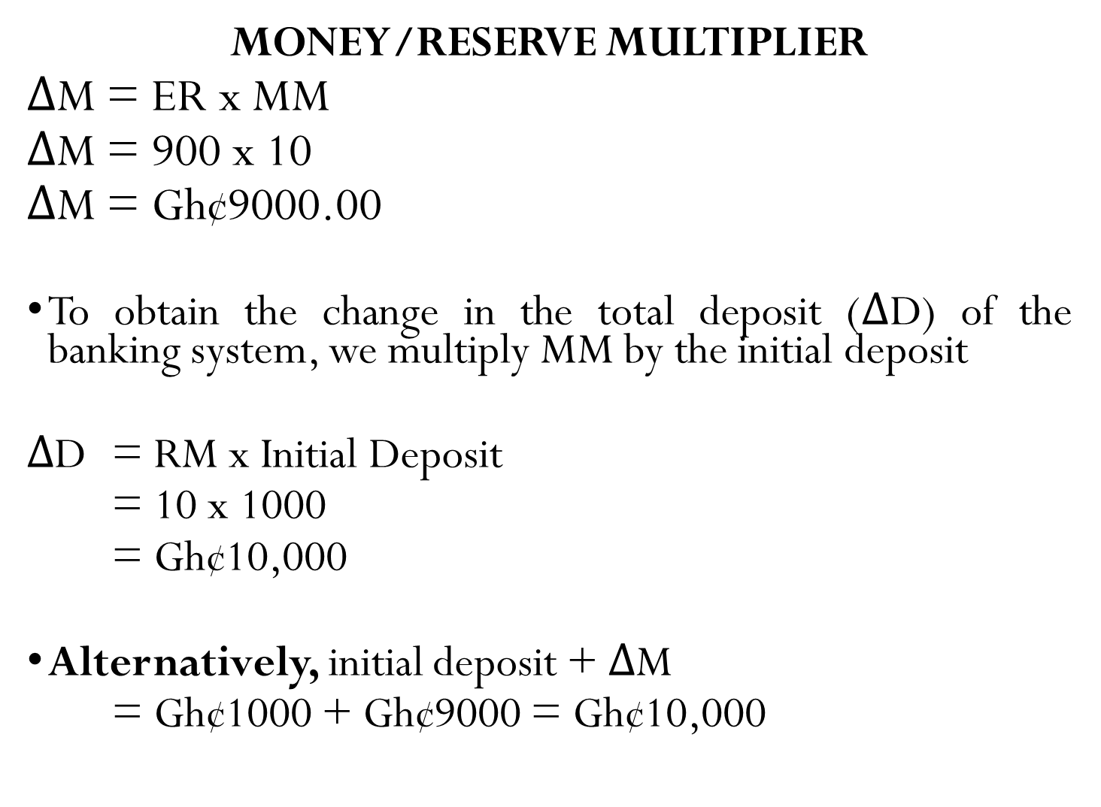
Notes:
7

Slide 48
MONEY CREATION
What causes money supply to rise?
Banks hold a lower reserve ratio
The non-bank private sector chooses to hold less cash
An inﬂow of funds from abroad
A public-sector deﬁcit
The public-sector net cash requirement (PSNCR) is the difference between public-sector expenditure and public sector receipts.
To meet this deficit, the government has to borrow money by selling interest-bearing securities (Treasury bills and gilts).
In general, the bigger the PSNCR, the greater will be the growth in the money supply

Slide 49
If an extra GH¢100m is deposited in the banking system and the bank deposits multiplier is 5, by how much can credit expand?
Q
GH¢80m
GH¢180m
GH¢400m
GH¢500m

Slide 50
In an economy where all commercial banks keep ten per cent of their deposits in liquid assets, total bank assets would be increased by GH¢ 100 million if bank holdings of cash increased by:
Q
GH¢10,000 million
GH¢1000 million
GH¢100 million
GH¢10 million
GH¢1 million

Slide 51
Which of the following methods of financing an increase in the public-sector net cash requirement will lead to an increase in the money supply?
Q
Sales of securities to overseas purchasers
Sales of bonds to the non-bank private sector
Sales of Treasury bills to the non-bank private sector
Sales of Treasury bills to the banking sector
Sales of bonds to the banking sector

Slide 52
Questions
‘The greater the number of types of asset that are counted as being liquid, the smaller will be the bank multiplier’. True/False?
The amount a bank is legally required to keep in the form of liquid assets refers to required reserve. True/False?
The smaller the reserve required ratio, the larger the credit that commercial banks can create. True/False

Slide 53
The relationship between money supply and the rate of interest

Slide 54
The relationship between money supply and the rate of interest
Simple monetary theory often assumes that the supply of money is totally independent of interest rates.
Keynesian models, assume that higher interest rates will lead to higher levels of money supply. The reasons for this are:
Increases in money supply may occur as a result of banks expanding credit in response to the demand for credit.

Slide 55
The relationship between money supply and the rate of interest
Higher interest rates may encourage depositors to switch their deposits from sight accounts (earning little or no interest) to time accounts.
Higher interest rates attract deposits from overseas.

Slide 56
The relationship between money supply and the rate of interest
In this class, we assume that the money supply is exogenous.
It is assumed to be determined by government or the monetary authorities.
The money supply curve is vertical as shown below:

Slide 57
The supply of money curve: (a) exogenous money supply
M_{S}
The supply of money is not affected by the demand for money.
Rate of interest
O
Quantity of money

Slide 58
The Demand for Money

Slide 59
The Demand for Money
The demand for money refers to the desire to hold money: to keep your wealth in the form of money, rather than spending it on goods and services or using it to purchase financial assets such as bonds or shares.
That is, demand for money describes the desire or willingness to hold a given stock of money for any reason

Slide 60
The motives for holding money (Liquidity preference)
Transactioanary and precautionary demand for money: L1
Speculative(asset) demand for money: L2

Slide 61
The motives for holding money
Transactionary demand for money: This refers to the amount of money held by households and firms to meet daily expenditure trend
Factors influencing the transactions purposes:
The price level
Financial innovation (E.g., Credit card and Automatic Teller Machine (ATM) card)
Institutional factors (E.g., length of time between paydays)
The size of the firm
Income level
The rate of interest has some effect on L1
Season of the year

Slide 62
The transactions-plus-precautionary demand for money: L₁
Rate of interest
L₁
O
Active balances

Slide 63
The motives for holding money
Speculative demand for money (L2):Holding money against the uncertainty inherent in the fluctuating prices of bonds and other financial assets is termed as speculative balance
People hold their financial assets in many forms:
Private or Government bonds
Demand deposits
Corporate stock etc.

Slide 64
The motives for holding money
The speculative motive implies that the demand for money is negatively related to the rate of interest
A fall in the interest rates will be a loss to those holding bonds as assets, prompting investors to hold money instead of bonds

Slide 65
The speculative demand for money: L₂
Rate of interest
L₂
O
Idle balances

Slide 66
Determinants of the speculative demand for money
The rate of interest (or rate of return) on assets.
Assume that the government issued a Gh¢100 bond at a time when interest rates were 10 per cent. Assume, for example, that interest rates fall to 5 per cent. What will happen to the market price of the bond paying Gh¢10 per year?

Slide 67
Determinants of the speculative demand for money
2. Expectations of changes in the prices of securities and other assets
If people believe that share prices are about to rise rapidly on the stock market, they will buy shares now
If they think that share prices will fall, they will sell them and hold money instead
3. Exchange rate

Slide 68
Total Demand For Money
The total demand for money is found by the horizontal addition of curves L1 and L2. This curve is known as the ‘liquidity preference curve’ or simply the demand for money curve.
Any factor, other than a change in interest rates, that causes the demand for money to rise will shift the L curve to the right.
For example, a rise in national income will cause L1 to increase, and thus L will shift to the right.

Slide 69
The total demand for money curve: L (= L₁ + L₂)
Rate of interest
L ( = L₁ + L₂)
L₂
L₁
O
Total money balances

Slide 70
Which one of the following would NOT increase the demand for money?
Q
People are paid less frequently.
People decide to holder larger precautionary balances of money.
Property prices are expected to rise.
Speculators believe that interest rates will rise.
Speculators believe that the exchange rate index will rise.

Slide 71
Money and Interest Rates
Equilibrium in the Money Market

Slide 72
Money and Interest Rates
Equilibrium in the money market is where the demand for money (L) is equal to the supply of money (Ms)
In the money market, the point at which the quantity of money demanded equals the quantity of money supplied determines the equilibrium interest rate in the economy

Slide 73
Equilibrium in the money market
M_{S}
Rate of interest
r_{e}
L
O
M_{e}
Money

Slide 74
Equilibrium in the money market
M_{S}
Rate of interest
r_{e}
L
O
M_{e}
Money

Slide 75
Equilibrium in the money market
Effects of changes in the money supply or demand on the rate of interest
Notes:
11

Slide 76
(a) Increase in demand for money
M_{S}
r1
Rate of interest
r_{e}
L1
L0
O
M1
M_{e}
Money

Slide 77
(b) Increase in Money Supply
M_{S1}
M_{S2}
Rate of interest
r_{e}
r2
L
O
M_{e1}
M2
Money

Slide 78
If money supply increases further, all the money will be held as idle balances without interest rate falling any further.
Such a situation is referred to as Liquidity Trap
Notes:
11

Slide 79
Liquidity Trap
M_{S1}
M_{S2}
M_{S3}
M_{S4}
Rate of interest
r_{e}
r2
r3
L₂
O
M_{e}
M2
Money

Slide 80
THANK YOU
Notes:
11

